Slide 1
HOS303A: International Restaurant Concepts
Topic 3

Slide 2
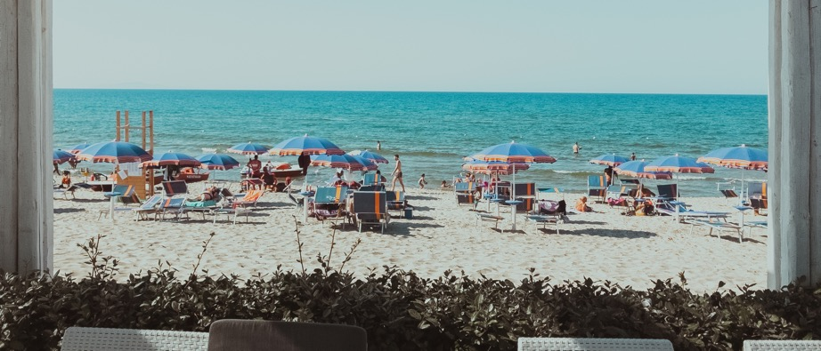

International Restaurant Concepts
Location, Location, Location
Selecting a restaurant location is both a science and an art.

Slide 3

Weekly Content
The relationship between location, markets and concept
Factors to take into consideration when choosing a location
  Accessibility/ Footfall and Traffic
  Proximity to other venues
  History of the site
Hidden Locations
Assessing the suitability of a location
Examples of Target Markets and Locations

Slide 4
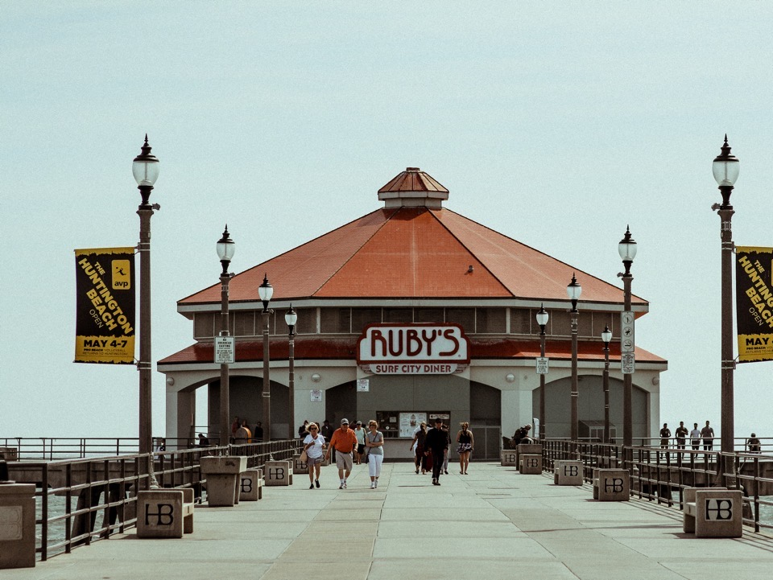
3.1: Pre-class Activity Review
This week, we’re exploring choosing the right location for a restaurant concept.
This is closely related to target markets, so ensure you’ve refreshed your memory from last week’s content and completed the quiz in preparation for today’s class.

Slide 5
Concept and Market
Quality
Menu
Price
Atmosphere
Location
Management
Food
Service
(Walker, 2014, page 67)

Slide 6
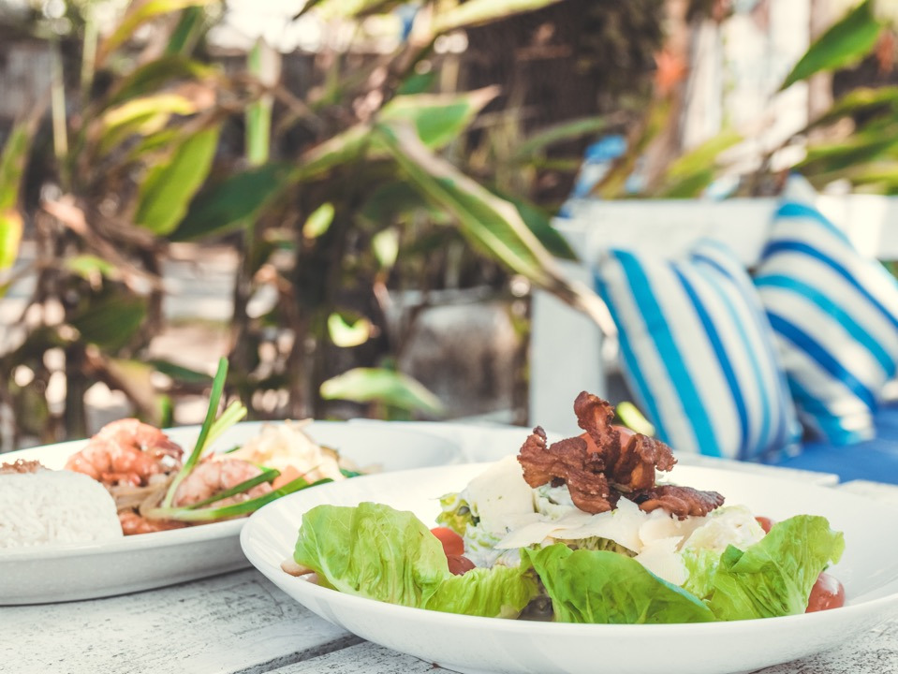
Activity 3.2
Review of your Competitor Demographic Analysis from last week (Activity 2.3)
Select a Restaurant Concept (Café, Thai restaurant etc.) in your neighbourhood.
You completed the Competitor Demographic Analysis template on Moodle. Now share your findings with the class.

Slide 7
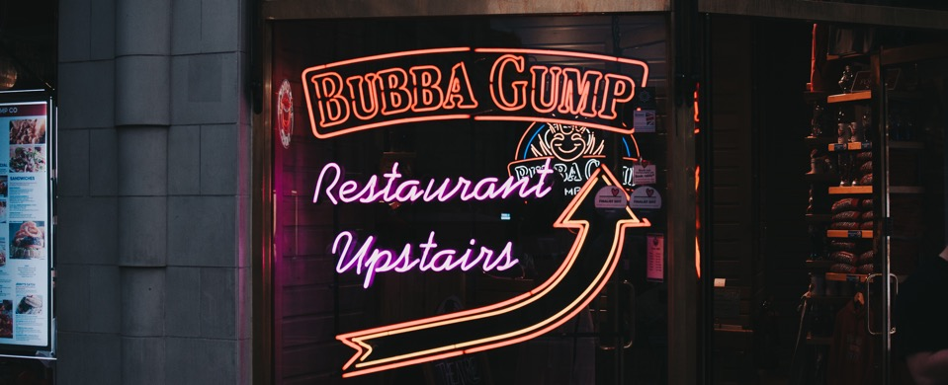
Activity 3.3
Reflect
When was the last time you experienced a new food and beverage venue?
What was the reason behind your decision to do so? Online review, word of mouth, walked past etc.?

Slide 8

How to Pick a Location | Restaurant Business
(Howcast, 2013)
Notes:
Video here: https://www.youtube.com/watch?v=btcDbJ0u-j0

Slide 9
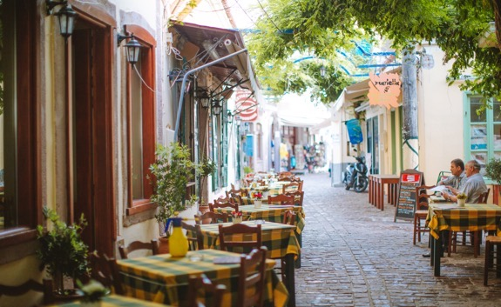

Location Criteria
Demographics of the area: age, occupation, religion, nationality, culture, family size, educational level, average income of individuals and families (see Topic 2)
Visibility from a busy road
Accessibility from a busy road
Distance from the potential market
Desirability of surroundings
(Adapted from Walker, 2017)

Slide 10

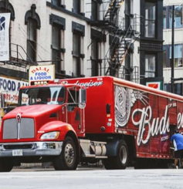

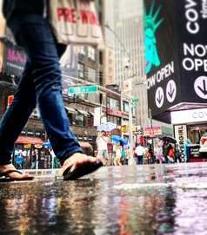
Accessibility
Access to public transport
Parking
Delivery
Physically getting to the venue within a building
Visibility: can be seen for a reasonable amount of time? Are potential guests walking or driving?
Good visibility is vital to a QSR and may be slightly less important to a full-service restaurant. Consider signage or a narrow store front.
(Lynn at al 2012)

Slide 11
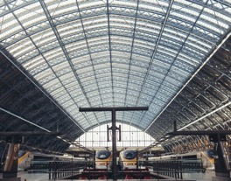
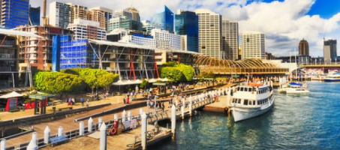
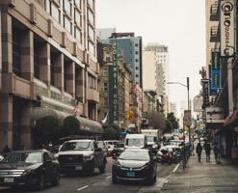

Footfall / Foot Traffic
Busy roads mean more eyeballs
If you are relying on strong pedestrian traffic, consider whether or not nearby businesses will generate foot traffic for you.
Transport hubs- could this affect your busy periods?
Traffic density: Consider pedestrian traffic during business hours and the percentage of it that is likely to patronise
In some locations, high traffic means busy people who might not notice your restaurant or stop long enough to read signs
(Restaurant Choosing a Location, n.d.)

Slide 12

The Restaurant Man
“We look for indicators – good footfall, a nice part of town, theatres, cinemas and what have you – but with restaurants, a difference of 50 feet can be the difference between profit and loss.”
(Russel Norman, 2016)
Notes:
Full article here: https://www.sussexlife.co.uk/people/russell-norman-on-opening-polpo-in-brighton-1-4379128

Slide 13
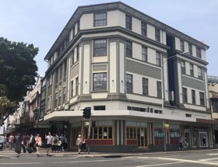

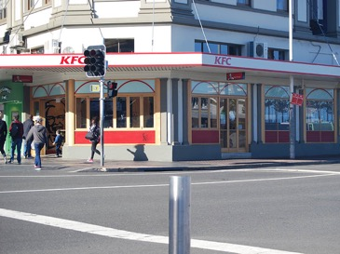
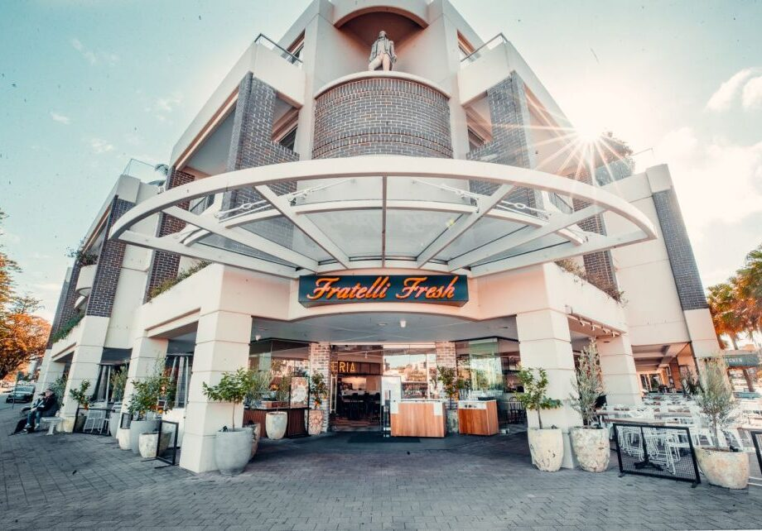
Consider Manly Wharf Crossing
Which side is busier?
Did footfall affect the success of KFC and Criniti’s? What about Fratelli Fresh?

Slide 14
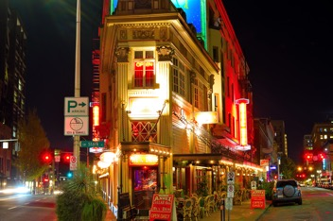

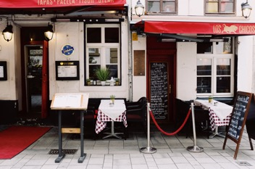
Rental and Lease
Cost of remodelling an existing building / cost of buying an existing restaurant.
If rents are too high, then certain types of cuisine and concepts might make it hard to earn enough profits. Negotiate!
Terms of the lease. Be sure you understand all the details of the lease, because it's possible that an excellent site may have unacceptable leasing terms.
Residents with higher disposable incomes might justify paying a higher rent. Real estate prices are a good way to measure the local economy’s health and affluence.

Slide 15
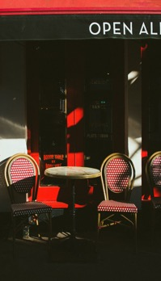

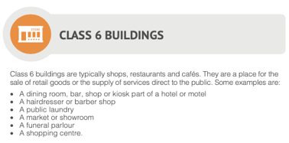
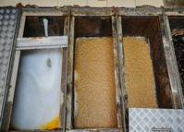
Layout, Zoning, Building Classifications
Check the building classifications and approvals
How many covers and average spend per head to be profitable?
Liquor license and outdoor seating precedents?
Drainage, sewage, utilities, grease traps
If a site is impossible to use because of the unavailability of certain utilities. Do you require the use of gas or charcoal?
Flooding history, major drainage problems?
*More on this in future topics…
(Commercial Property Guide, 2016)
Notes:
Building classes and classifications in Australia: https://www.commercialpropertyguide.com.au/blog/investing/building-classes-and-classifications-in-australia-47

Slide 16
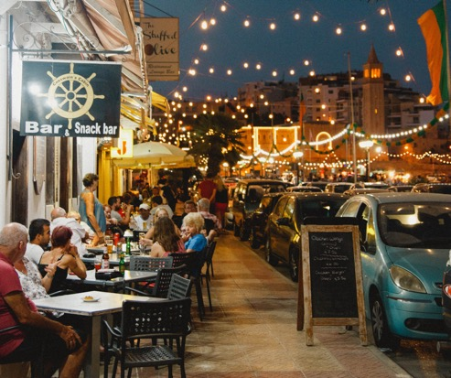

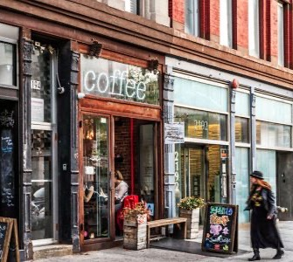
Surroundings and Nearby Competitors
Studying restaurants in the area gives clues about local trends
If three successful fast food restaurants operate nearby, a fourth might challenge the market or decide the pool of customers is insufficient.
History of the building- why did previous occupiers fail? Too much competition?
Is there an issue with theft in the area? Do the residents upstairs complain when there’s live music?
Are there pending planning permission applications that could affect your trade?
Example: A bakery concept could also face competition from in-store bakeries in supermarkets
(Choosing a Restaurant Location, n.d.)
Notes:
See full content here: Choosing a Restaurant Location: https://www.restohub.org/operations/planning/choosing-a-restaurant-location/

Slide 17
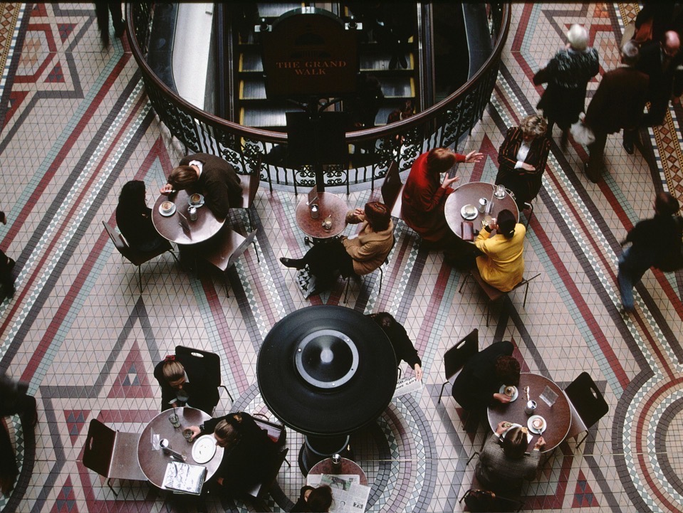
Activity 3.4
Compare a café in Manly, Darlinghurst and in CBD
How does the same concept vary with location?
https://icms.padlet.org/nassima_kennedy1/yzhbu4fptlg2rlex

Slide 18
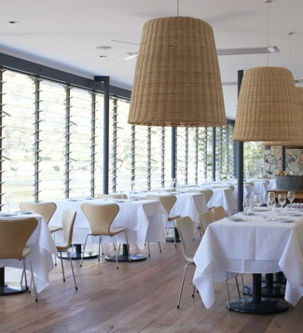
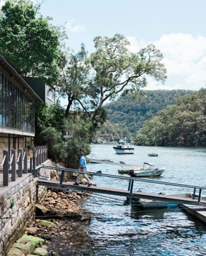

Some restaurants create their own location…
The restaurant creates the location if the food service and atmosphere are desirable.
Developers and community officials are often eager to entice a successful restaurant operator into a new shopping centre or an area that has fallen on bad times.
People will search out appealing restaurants
(Walker, 2017, page 85)
Berowra Waters Inn
Notes:
See more about the restaurant here: https://www.berowrawatersinn.com

Slide 19
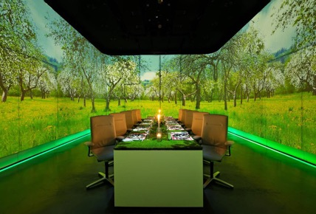
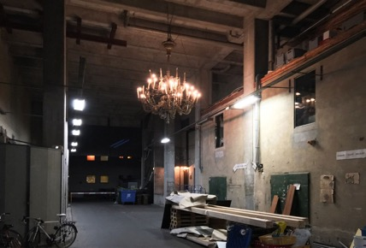
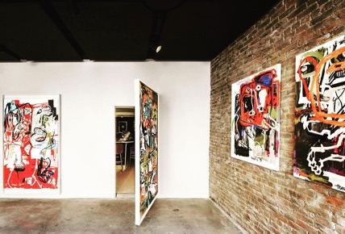
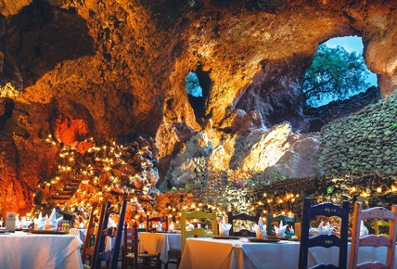
Hidden Venues
Ultraviolet by Paul Pairet, Shanghai
The location is top secret and booked diners are transported to the restaurant via a minivan
Cookies and Cream, Berlin
The address leads visitors into an unused ground floor space- the clue is the Chandelier
Frevo, New York
Hidden inside an art gallery
La Gruta, North East of Mexico City
Hidden by a pyramid built by the Aztecs almost 2,000 years ago
(Huynh, 2020)
Notes:
Full article here: https://www.theceomagazine.com/lifestyle/food-beverage/best-hidden-restaurants/

Slide 20
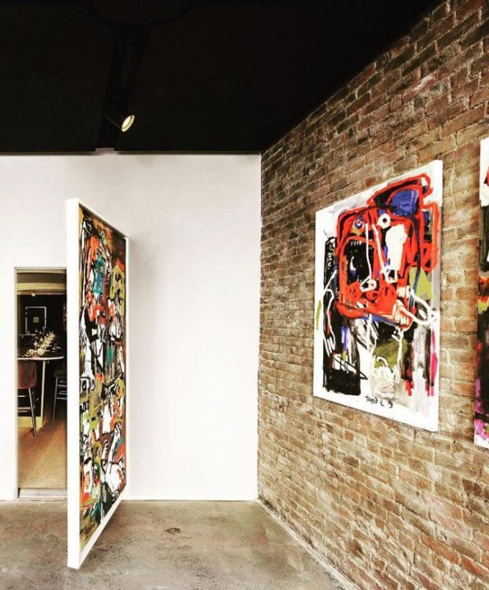
Activity 3.5
Consider Hidden Venues
Have the locations affected the success of the venues?
Will this remain the case in the future?
What could be the threats to the success of these venues in the future?

Slide 21
Some Sources of Information
Australian Bureau of Statistics (Assessment 1): https://quickstats.censusdata.abs.gov.au/census_services/getproduct/census/2016/quickstat/1
Local Planning and Zoning
https://www.planning.nsw.gov.au/Plans-for-your-area/Local-Planning-and-Zoning
US Census Bureau (Assessment 2): https://www.census.gov/programs-surveys/metro-micro.html
Restaurant, Food & Beverage Market Research Handbook 2016-2017 (Available via EBSCO)
The Food People
https://thefoodpeople.co.uk/infographics/food-and-beverage-trends-2019-australia

Slide 22
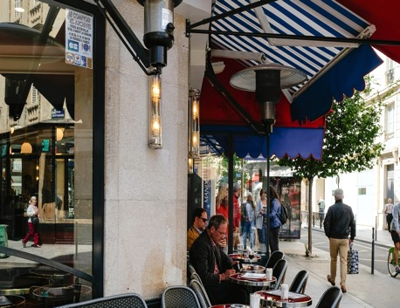
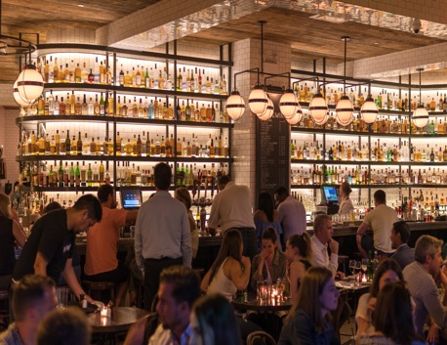
Location Knockout Criteria
What’s the minimal size you will need for your location and venue?
  Consider number of diners and average spends
Duration of lease?
  Is it less than 5 years- are you looking at testing a pop-up concept?
Visibility from both sides of the road?
  Will that be important to your venue?
Excessive traffic speed?
  Could be an issue if drivers distracted when passing the venue.
Average travel time to reach the restaurant?
  Are you a café or a fine dining special occasion venue?
Proper zoning (Century 21, 2017)
  Is it heritage? Opportunity for extensions/ renovations? Flood zoning?
(Walker, 2014, page 90)
Notes:
See here: What is zoning?: https://www.century21.com.au/post/what-is-zoning-century-21

Slide 23
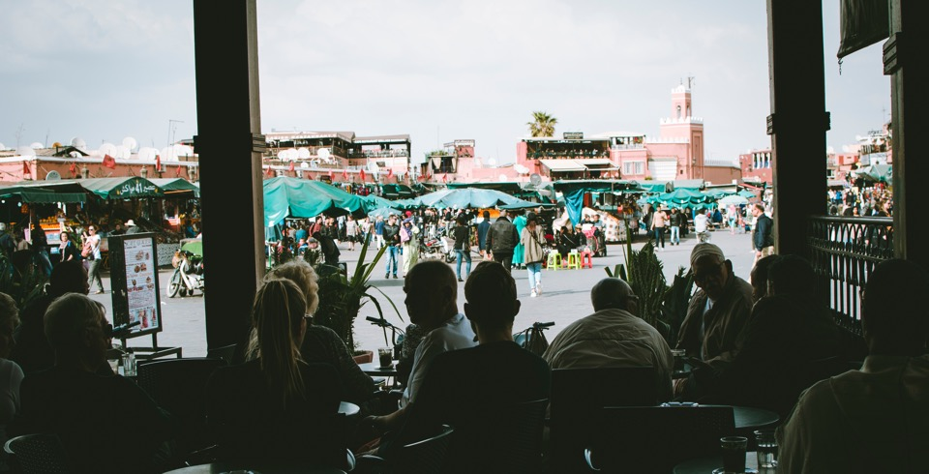

Closing Thoughts…
There are many factors to consider when selecting a restaurant location
Get the right concept in the wrong location and it will be challenging
Get the right location and the wrong concept, you will struggle
Make sure the concept and location fit
Selecting a restaurant location is both a science and an art…

Slide 24

Sources
Choosing a Restaurant Location (n.d). RestoHub. Retrieved from https://www.restohub.org/operations/planning/choosing-a-restaurant-location/
Entrepreneur Advice / Evan Carmichael (2019, April 11), Restaurant Success: How to Choose the PERFECT Location [Video file]. Retrieved from https://www.youtube.com/watch?v=-Mj6-jHuSgU
Howcast (2013, July 26). How to Pick a Location | Restaurant Business [Video file]. Retrieved from https://www.youtube.com/watch?v=btcDbJ0u-j0
Huynh, M. (2020, January 14). World’s best hidden restaurants you’ll get lost trying to find. CEO Magazine. Retrieved from https://www.theceomagazine.com/lifestyle/food-beverage/best-hidden-restaurants/
Lynn, Jacquelyn & Entrepreneur Media, Inc (2012). Start your own restaurant and more : pizzeria, coffeehouse, deli, bakery, catering business (4th ed). Entrepreneur Press, [Irvine, Calif.]
Miller, R. K., Washington, K. D., & Richard K. Miller & Associates. (2018). Restaurant, Food & Beverage Market Research Handbook 2018-2019: Vol. 17th edition. Richard K. Miller & Associates.
Restaurant Choosing a Location (n.d.), Gourmet Marketing. Retrieved from https://www.gourmetmarketing.net/restaurant-essentials/choosing-a-restaurant-location/
Walker, J. R. (2017). The restaurant : from concept to operation. [Book] (8th ed.). John Wiley
Walker, J. R. (2014). The restaurant : from concept to operation. [Book] (7th ed.). John Wiley

Slide 25
Thank you
What questions do you have?...
COMMONWEALTH OF AUSTRALIA
Copyright Regulations 1969
WARNING
This material has been reproduced and communicated to you by or on behalf of International College of Management, Sydney pursuant to Part VB of the Copyright Act 1968 (the Act).
The material in this communication may be subject to copyright under the Act. Any further reproduction or communication of this material by you may be the subject of copyright protection under the Act.
Do not remove this notice.

